Slide 1
Visualization of COVID-19 situation in India (As of 16 Jun 2020)
Presented by: Aniket Kolkar

Slide 2
Introduction
The COVID-19 pandemic in India is part of the worldwide pandemic of coronavirus disease 2019 (COVID-19).
The first case of COVID-19 in India was reported on 30 January 2020.
As of 16 Jun 2020, total confirmed cases are 3,35,407, active cases are 1,45,494, recoveries are 1,80,494 and 9,900 deaths occurred in the country.
Data Source:
1) https://www.mohfw.gov.in/
2) https://www.covid19india.org/

Slide 3
Problem Statement
1. Changes in number of confirmed, active, deaths, recovered cases over time
2. Impact of Lockdown on spread of COVID-19
3. Daily growth in active, deaths, recovered cases
4. State wise distribution of confirmed cases
5. Hotspots in India
6.Active/Recovered/Deaths occurred state wise
7. State wise sample testing

Slide 4
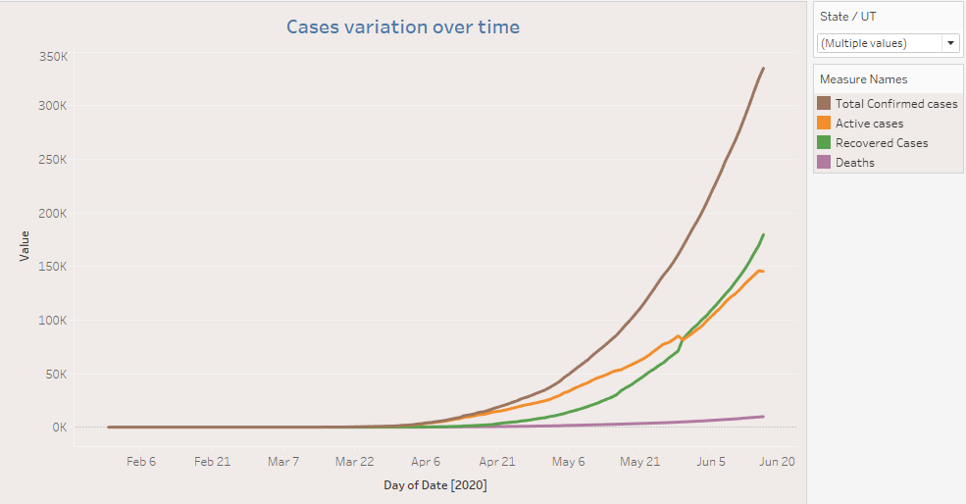
Changes in number of confirmed, active, deaths, recovered cases over time
During first 3 phases of lockdown spread of COVID-19 was in control
4th phase onward spread of COVID increases exponentially
Recovered cases take over to active cases

Slide 5
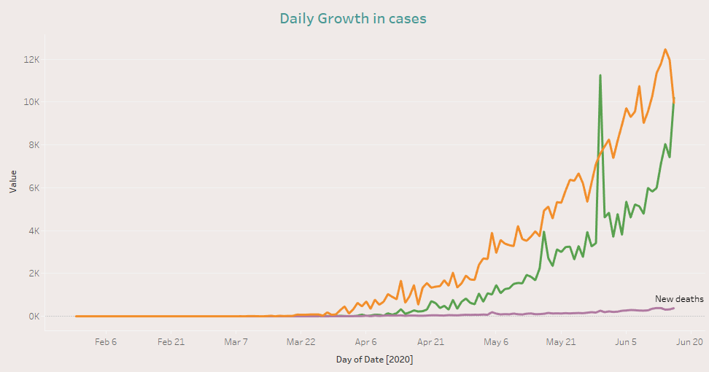
Daily Growth in cases
Spike occurred due to 8,381 cases got recovered in Maharashtra on 30 May
Active & recovered cases increasing linearly
On 16 Jun, more cases got recovered than active cases

Slide 6
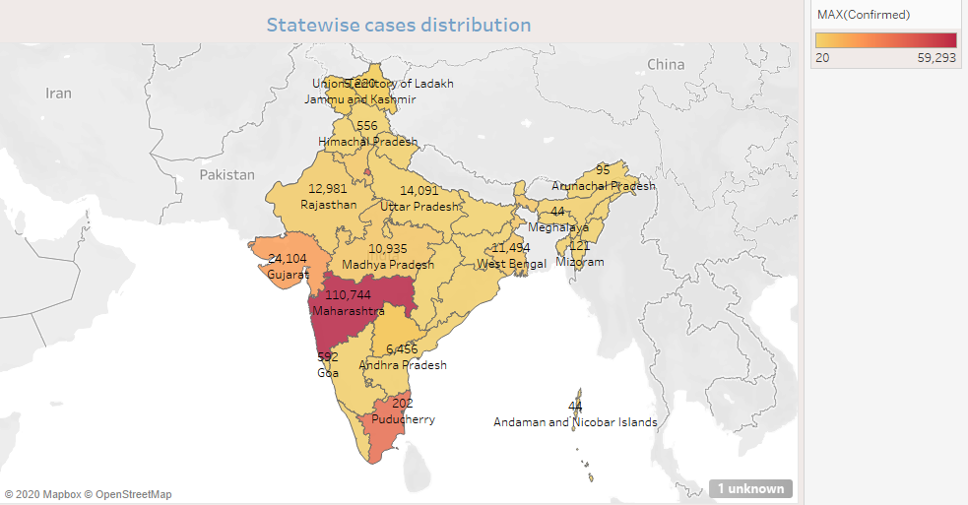
State wise Distribution of confirmed cases
Darker the color more the confirmed cases
Maharashtra has maximum confirmed cases followed by Delhi & Tamil Nadu

Slide 7
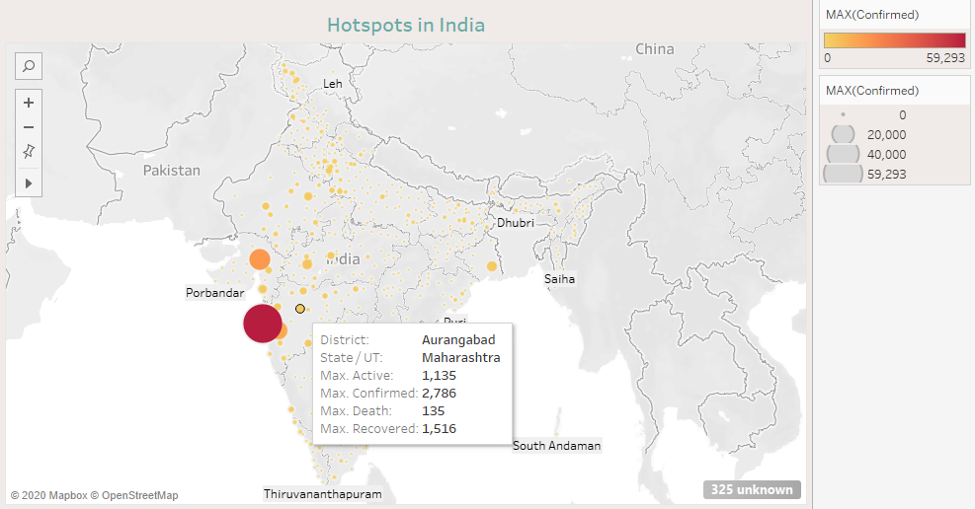
Hotspots in India
Hotspot cities in India
Darker the color more the confirmed cases
Mumbai is on top

Slide 8
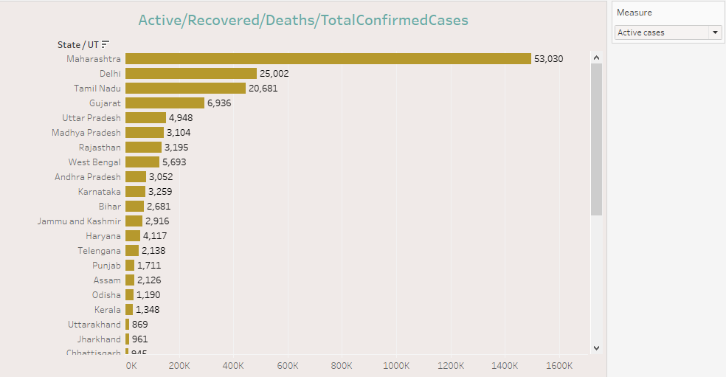
State wise distribution
Maharashtra breaks all the records in terms of all types cases
By selecting category we get state wise distribution according to that category

Slide 9
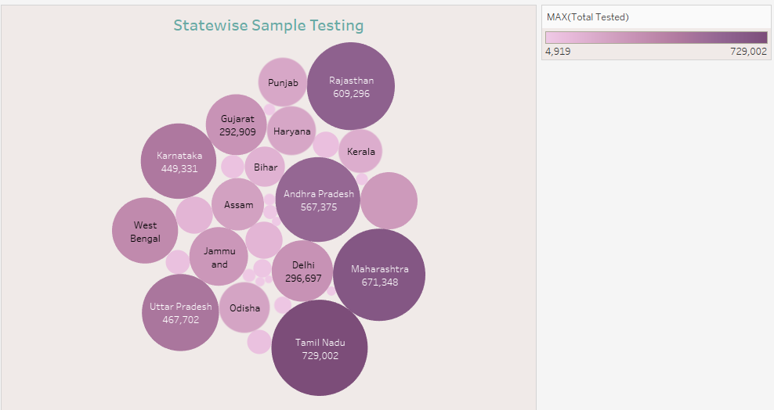
Samples tested
Larger & darker the circle more samples got tested
Tamil Nadu tested highest samples followed by Maharashtra & Rajastan

Slide 10
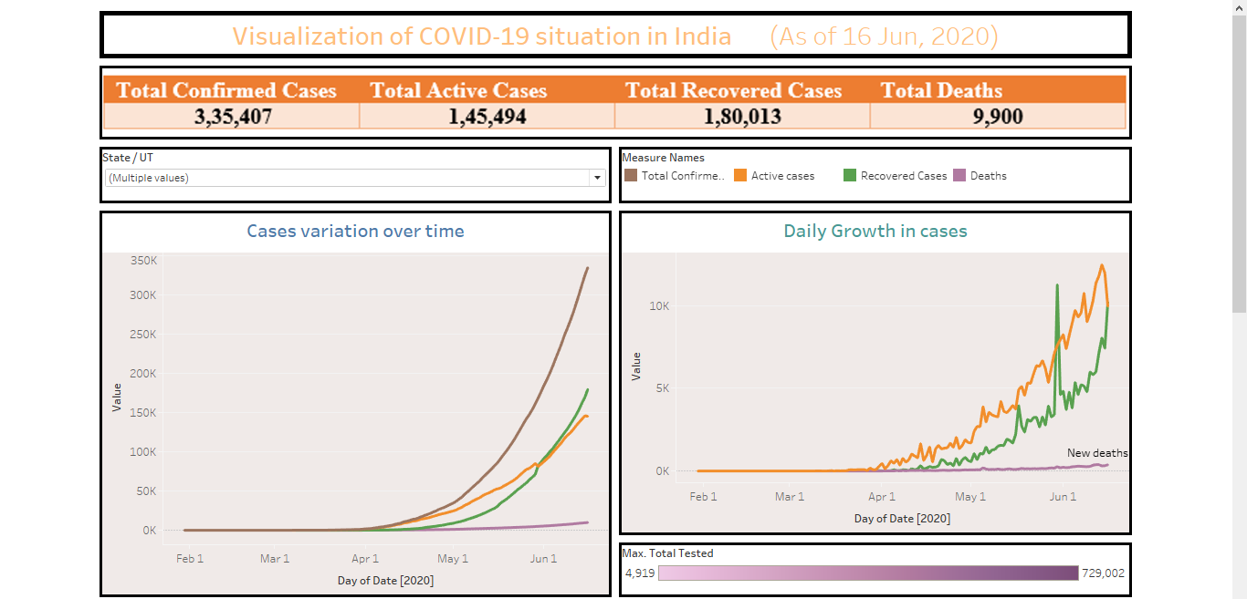
Dashboard (1)

Slide 11
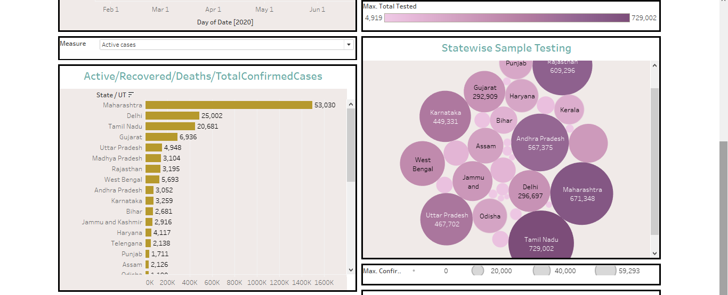
Dashboard (2)

Slide 12
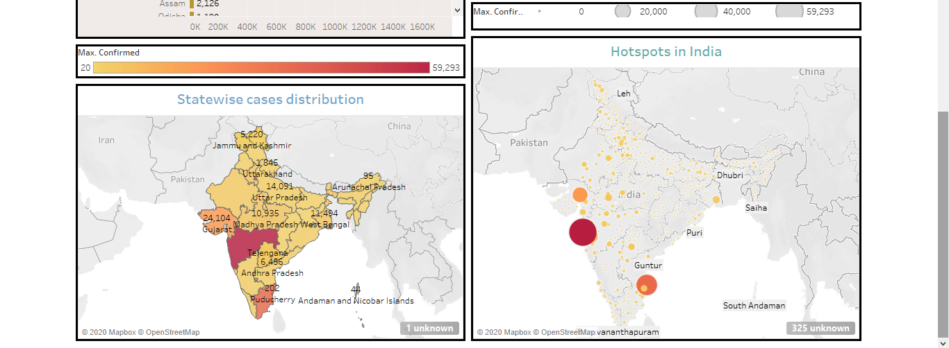
Dashboard (3)

Slide 13
Conclusion
During 1st 3 phases of lockdown spread of COVID-19 was in control
Relaxation in lockdown give rise to spread of COVID-19
Daily growth in active & recovered cases is linear
Maharashtra is highly affected by COVID-19
Approx. half of the cases of Maharashtra are in Mumbai
Tamil Nadu tested highest samples followed by Maharashtra
Andhra Pradesh has nearly 6.5k confirmed cases, but they tested nearly 567k samples
Also Rajasthan has nearly 13k confirmed cases, but they tested nearly 609k samples

Slide 14
Thank You

Slide 15
Video Presentation Link
https://drive.google.com/file/d/1v-bUS-yW5sm0JngvjnAPXK8_WPjpwnST/view?usp=sharing

